Slide 1


Welcome!
Join the conversation by opening the “Group Chat” widget in the dashboard.
Notes:
0:00

Slide 2

While you watch…
Take the survey and share with us your Easter memories and experiences.
Access the survey by clicking on the ”Survey” widget
icon in the dashboard.
Notes:
1:00

Slide 3
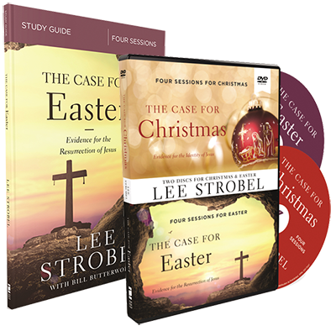
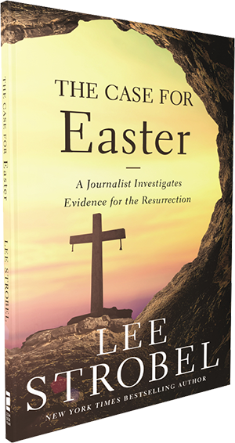

Exclusive Offer for Our
ChurchSource Channel Webcast Viewers
The Case for Easter
By Lee Strobel
40%
OFF
DVD & Study Guide Pack
$49.99 | NOW $29.99
Booklet
$2.99 ea. | NOW $1.80 ea. for 10+
Click on the links in the
“Resource List” widget to purchase.
Notes:
2:10

Slide 4
And if Christ has not been raised, your faith is futile; you are still in your sins.
“
”
-
Apostle Paul in
1 Corinthians 15:17 NIV
Notes:
Start at 3:51

Slide 5
I and the Father are one.
“
”
- Jesus in John 10:30 NIV
Notes:
Show at 4:38

Slide 6
We proclaim to you what we have seen and heard…
“
”
- 1 John 1:3 NIV
Notes:
Show at 7:59

Slide 7
For we did not follow cleverly devised stories when we told you about the coming of our Lord Jesus Christ in power, but we were eyewitnesses of his majesty.
“
”
- 2 Peter 1:16 NIV
Notes:
Show at 8:08

Slide 8
The 4 E’s to Summarize the Evidence of Christ
Execution – Death of Jesus
Notes:
Show at 9:23

Slide 9
The 4 E’s to Summarize the Evidence of Christ
Execution – Death of Jesus
Early Accounts – Early reports of Jesus’ resurrection
Notes:
Show at 10:56

Slide 10
The 4 E’s to Summarize the Evidence of Christ
Execution – Death of Jesus on the cross
Early Accounts – Early reports of Jesus’ resurrection
Empty Tomb – Evidence confirming the tomb was empty
Notes:
Show at 13:04

Slide 11
The 4 E’s to Summarize the Evidence of Christ
Execution – Death of Jesus on the cross
Early Accounts – Early reports of Jesus’ resurrection
Empty Tomb – Evidence confirming the tomb was empty
Eyewitnesses – 515 eyewitnesses of Jesus after resurrection
Notes:
Show at 13:38

Slide 12
The Case for Easter Video Bible Study
In this four-session video Bible study, Lee Strobel looks at the story of Jesus' resurrection and reveals how we can know that it actually took place. He explores the "discrepancies" critics have pointed to in the Gospel accounts, looks at the evidence that Jesus' tomb was truly empty, and shows how the eyewitness accounts of those who saw Jesus alive after the crucifixion are credible. Lee reveals how all the facts point to the conclusion that led him from atheism to Christianity: Jesus was the Son of God who conquered the grave.
DVD & Study Guide Pack
$49.99 | NOW $29.99
Notes:
15:04

Slide 13
While you watch…
Take the survey and share with us your Easter memories and experiences.
Access the survey by clicking on the ”Survey” widget
icon in the dashboard.
Notes:
16:20

Slide 14
Take a 4-session journey with Lee in
The Case for Easter Video Bible Study
40%
OFF
DVD & Study Guide Pack
$49.99 | NOW $29.99
Click on the links in the
“Resource List” widget to purchase.
Notes:
19:00

Slide 15
While you watch…
Take the survey and share with us your Easter memories and experiences.
Access the survey by clicking on the ”Survey” widget
icon in the dashboard.
Notes:
21:30

Slide 16
God took the worst possible thing that could ever happen in the universe which is the death of the Son of God on the cross and He turned it into the best thing that has ever happened in the universe which is the opening of heaven to all who follow Him.
“
”
- Peter Kreeft
Notes:
Start at 28:15

Slide 17
Take a 4-session journey with Lee in
The Case for Easter Video Bible Study
40%
OFF
DVD & Study Guide Pack
$49.99 | NOW $29.99
Click on the links in the
“Resource List” widget to purchase.
Notes:
29:10

Slide 18
Thank you for joining us!
Notes:
32:08

