Slide 1


Welcome!
Join the conversation by opening the “Group Chat” widget in the dashboard.
Notes:
0:00

Slide 2
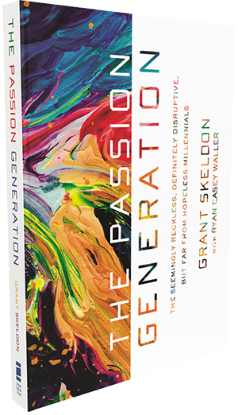

Exclusive Offer for Our
ChurchSource Channel Webcast Viewers
The Passion Generation
By Grant Skeldon
40%
OFF
Book
$16.99 | NOW $10.20
Click on the links in the
“Resource List” widget to purchase.
Notes:
0:58

Slide 3

Image from The Passion Generation by Grant Skeldon
Notes:
Start at 2:42

Slide 4
[On the Millennial Generation]
We have so much research but we don’t have a lot of results. We have so much statistics but we don’t have lot of solutions.
“
”
- Grant Skeldon
Notes:
Show at 3:30

Slide 5
I don’t know if there’s a more researched generation than this generation, yet they’re still the most misunderstood generation.
“
”
- Craig Groeschel
Notes:
Show at 3:38

Slide 6
POLL 1 PLACEHOLDER
Notes:
Show at 3:55

Slide 7
POLL 1 RESULTS PLACEHOLDER
Notes:
Show at 5:30

Slide 8
POLL 1 PLACEHOLDER
Notes:
Show at 6:40

Slide 9
POLL 1 RESULTS PLACEHOLDER
Notes:
Show at 8:15

Slide 10
Statistically most come to Christ when they’re young but they were never discipled when they were young. Most of our ministries are highly focused on conversion but they’re not focused on discipleship.
“
”
- Grant Skeldon
Notes:
Show at 9:35

Slide 11

Image from The Passion Generation by Grant Skeldon
Notes:
Start at 9:49

Slide 12
Exclusive Offer for Our
ChurchSource Channel Webcast Viewers
The Passion Generation
By Grant Skeldon
40%
OFF
Book
$16.99 | NOW $10.20
Click on the links in the
“Resource List” widget to purchase.
Notes:
11:40

Slide 13

Image from The Passion Generation by Grant Skeldon
Notes:
Start at 13:02

Slide 14
Discipleship is:
Are you frequently following someone who is spiritually a step ahead?
“
”
- Grant Skeldon
Notes:
Show at 15:53

Slide 15
Exclusive Offer for Our
ChurchSource Channel Webcast Viewers
The Passion Generation
By Grant Skeldon
40%
OFF
Book
$16.99 | NOW $10.20
Click on the links in the
“Resource List” widget to purchase.
Notes:
16:40

Slide 16

Have an idea?
Share your thoughts on discipleship in the idea widget
Notes:
17:40

Slide 17
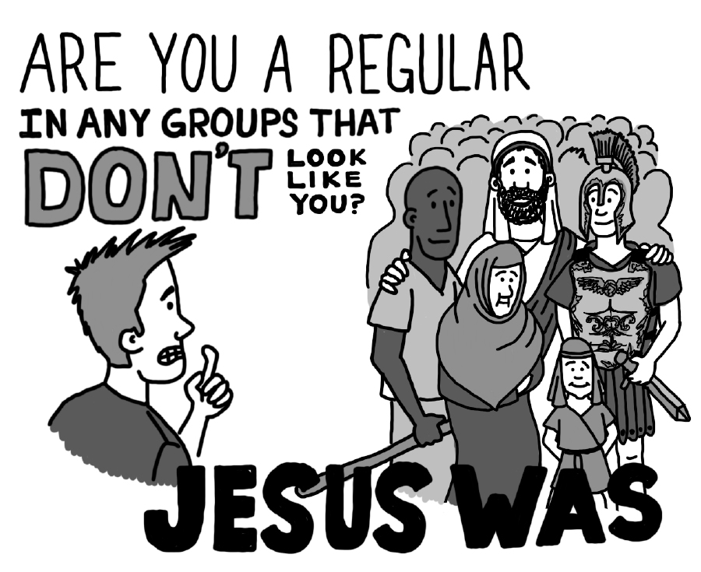
Image from The Passion Generation by Grant Skeldon
Notes:
Start at 19:53

Slide 18
Say hello to others…
Join the conversation by opening the “Group Chat” widget in the dashboard.
Notes:
21:21

Slide 19
Exclusive Offer for Our
ChurchSource Channel Webcast Viewers
The Passion Generation
By Grant Skeldon
40%
OFF
Book
$16.99 | NOW $10.20
Click on the links in the
“Resource List” widget to purchase.
Notes:
22:31

Slide 20

Image from The Passion Generation by Grant Skeldon
Notes:
Start at 23:55

Slide 21
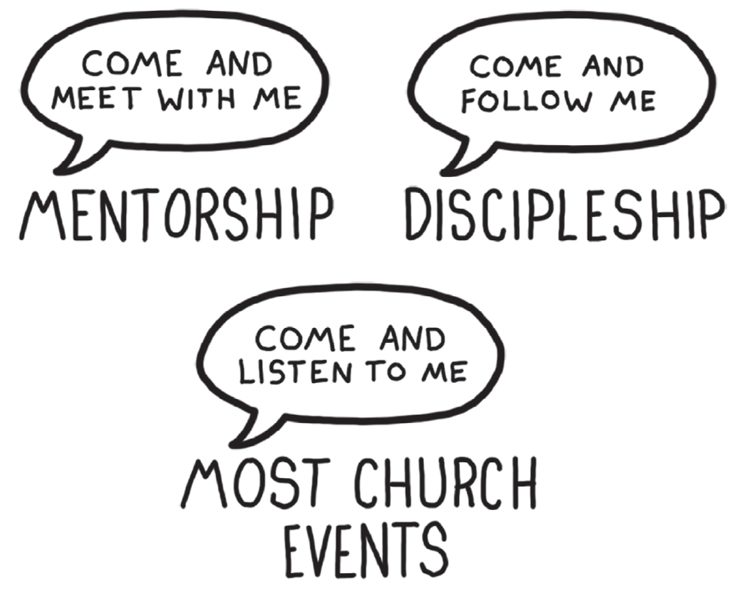
Image from The Passion Generation by Grant Skeldon
Notes:
Start at 26:19

Slide 22
Church has been dwindled down to two people doing two things for about two hours.
“
”
- Grant Skeldon
Notes:
Show at 26:58

Slide 23
Wherever we are, there the church is.
“
”
- Grant Skeldon
Notes:
Show at 28:19

Slide 24
Churches don’t make people Christians.
Christians make buildings churches.
“
”
- Grant Skeldon
Notes:
Show at 28:31

Slide 25
Exclusive Offer for Our
ChurchSource Channel Webcast Viewers
The Passion Generation
By Grant Skeldon
40%
OFF
Book
$16.99 | NOW $10.20
Click on the links in the
“Resource List” widget to purchase.
Notes:
28:44

Slide 26
Have an idea?
Share your thoughts on discipleship in the idea widget
Notes:
29:30

Slide 27
“You unbelieving and perverse generation,” Jesus replied, “how long shall I stay with you?
How long shall I put up with you?
“
”
- Matthew 17:17 NIV
Notes:
Show at 30:50

Slide 28
The Passion Generation:
The Seemingly Reckless, Definitely Disruptive, But Far From Hopeless Millennials
Written by a millennial, The Passion Generation will guide you beyond the stats of what millennials are doing to the why they’re doing it and how we can all move toward healthy community.
With wit, compassion, and startling insights, this book shares stories and studies drawn from Skeldon’s years of working to bridge generational gaps. In his signature conversational style, Skeldon offers researched strategies that will spark healthy connections, and practical methods that will help you disciple the millennials you love.
Book
$16.99 | NOW $10.20
Notes:
32:35

Slide 29
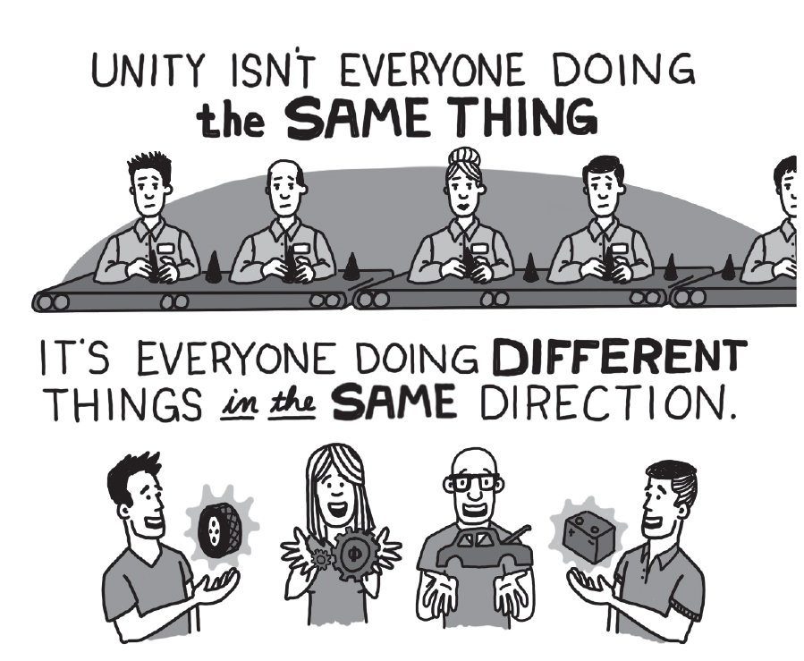
Image from The Passion Generation by Grant Skeldon
Notes:
Start at 33:29

Slide 30
Exclusive Offer for Our
ChurchSource Channel Webcast Viewers
The Passion Generation
By Grant Skeldon
40%
OFF
Book
$16.99 | NOW $10.20
Click on the links in the
“Resource List” widget to purchase.
Notes:
33:55

