Slide 1


Welcome!
Send in your questions to Steve for the
Live Q&A at the end!
Notes:
0:00

Slide 2
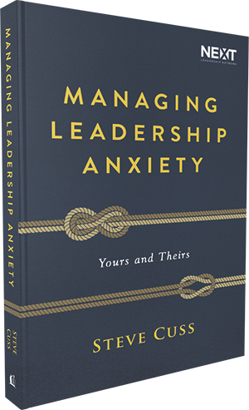

Exclusive Offer for Our
ChurchSource Channel Webcast Viewers
40%
OFF
Managing Leadership Anxiety
By Steve Cuss
Book
$18.99 | NOW $11.40
Click on the links in the
“Resource List” widget to purchase.
Notes:
0:58

Slide 3
Got Questions?
Send in your questions to be answered LIVE by Steve towards the end of the webcast.
Use the Q&A widget to submit your questions
Notes:
1:58

Slide 4

Take the survey
Be sure to fill out the survey to let Steve know what you’d like to hear next about managing anxiety.
Fill out the survey by clicking on the survey widget
in the dashboard.
Notes:
2:30

Slide 5
Anxiety isn’t simply worry.
Anxiety is any response that is trying to occupy the same space that God is occupying in our life.
“
”
- Steve Cuss
Notes:
Show at 2:56

Slide 6
Anxiety is a spiritual force that competes for the space where God is.
“
”
- Steve Cuss
Notes:
Show at 3:13

Slide 7
Managing Leadership Anxiety
Step 1: Notice it physiologically
Notes:
3:55

Slide 8
Got Questions?
Send in your questions to be answered LIVE by Steve towards the end of the webcast.
Use the Q&A widget to submit your questions
Notes:
4:35

Slide 9
Managing Leadership Anxiety
Step 1: Notice it physiologically
Step 2: Ask: What is it in this situation that I think I need but I don’t really need?
Step 3: Ask: What are situations that I avoid?
Notes:
Poll started 5:24, show this slide: 7:26

Slide 10
You can broaden your leadership capacity by getting in touch with what you are afraid of and what you are avoiding.
“
”
- Steve Cuss
Notes:
Show at 8:43

Slide 11
One of the sources of anxiety for leaders is that we often carry a load that’s not ours to carry.
“
”
- Steve Cuss
Notes:
Show at 9:11

Slide 12
Differentiation is the ability to know where you end and the other person begins.
“
”
- Steve Cuss
Notes:
Show at 9:35

Slide 13
We tend to shortcut the process because we don’t know how to be non-anxious when someone is anxious around us.
“
”
- Steve Cuss
Notes:
Show at 13:15

Slide 14
Ask yourself – What is my tendency as a leader?
“ ”
- Steve Cuss
Notes:
Show at 13:41

Slide 15
What is mine to carry and what is the other person’s to carry?
“
”
- Steve Cuss
Notes:
Show at 14:28

Slide 16
Got Questions?
Send in your questions to be answered LIVE by Steve towards the end of the webcast.
Use the Q&A widget to submit your questions
Notes:
15:15

Slide 17
Managing Leadership Anxiety
Yours and Theirs
This book offers valuable principles
to those who are hungry to understand
the source of the anxiety in themselves and in the people with whom they relate.
Readers will be empowered to take back control of their lives and lead in mature and vibrant ways.
Notes:
16:00

Slide 18
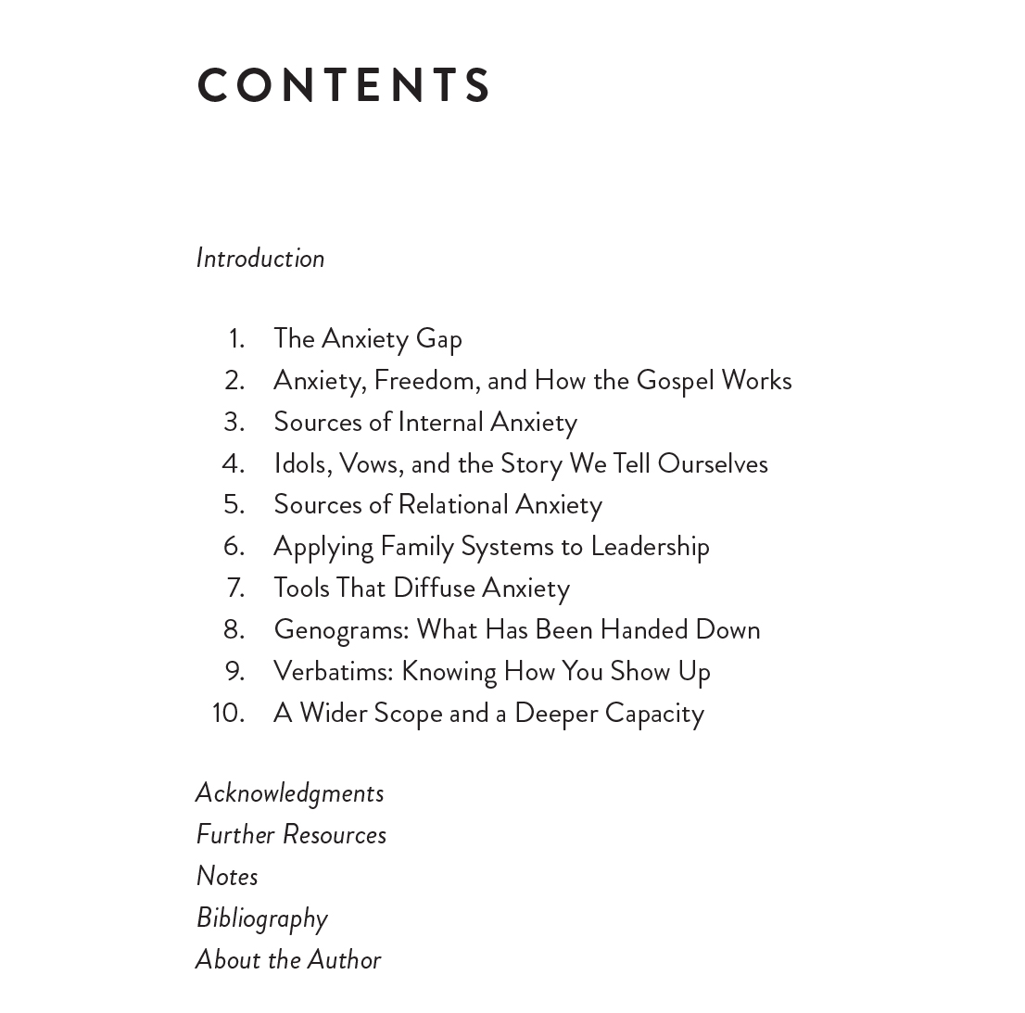
Book:
Table of Contents
Notes:
16:30

Slide 19
Take the survey
Be sure to fill out the survey to let Steve know what you’d like to hear next about managing anxiety.
Fill out the survey by clicking on the survey widget
in the dashboard.
Notes:
17:00

Slide 20
Book:
Table of Contents
Notes:
17:30

Slide 21
Take the survey
Be sure to fill out the survey to let Steve know what you’d like to hear next about managing anxiety.
Fill out the survey by clicking on the survey widget
in the dashboard.
Notes:
18:00

Slide 22
Book:
Table of Contents
Notes:
18:30

Slide 23
Take the survey
Be sure to fill out the survey to let Steve know what you’d like to hear next about managing anxiety.
Fill out the survey by clicking on the survey widget
in the dashboard.
Notes:
19:25

Slide 24
Exclusive Offer for Our
ChurchSource Channel Webcast Viewers
40%
OFF
Managing Leadership Anxiety
By Steve Cuss
Book
$18.99 | NOW $11.40
Click on the links in the
“Resource List” widget to purchase.
Notes:
19:33

Slide 25
Got Questions?
Send in your questions to be answered LIVE by Steve towards the end of the webcast.
Use the Q&A widget to submit your questions
Notes:
19:40

