Slide 1


Welcome!
Send in your questions to Pete for the
Live Q&A at the end!
Notes:
0:00

Slide 2


Emotionally Healthy Discipleship Course
By Pete Scazzero
Leader’s Kit
$149.99 | NOW $89.99
40%
OFF
Click on the kit icon to purchase.
Notes:
0:58

Slide 3
Got Questions?
Send in your questions to be answered LIVE by Pete towards the end of the webcast.
Use the Q&A widget to submit your questions
Notes:
2:30

Slide 4

Notes:
Show at 5:20

Slide 5
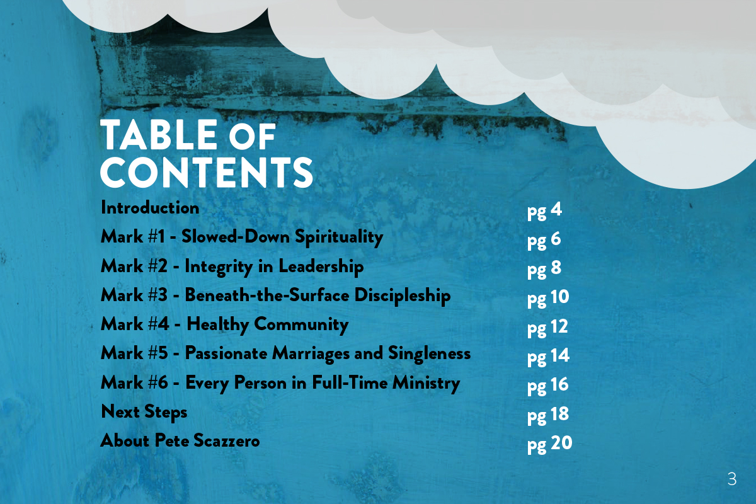
Notes:
Show at 5:35

Slide 6
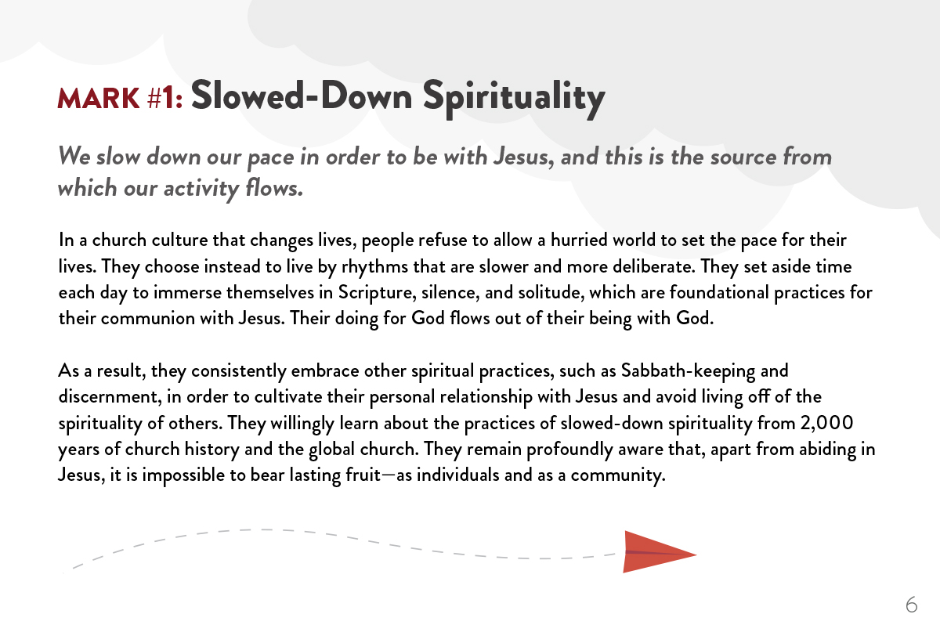
Notes:
Show at 5:50

Slide 7
Notes:
Show at 6:47

Slide 8
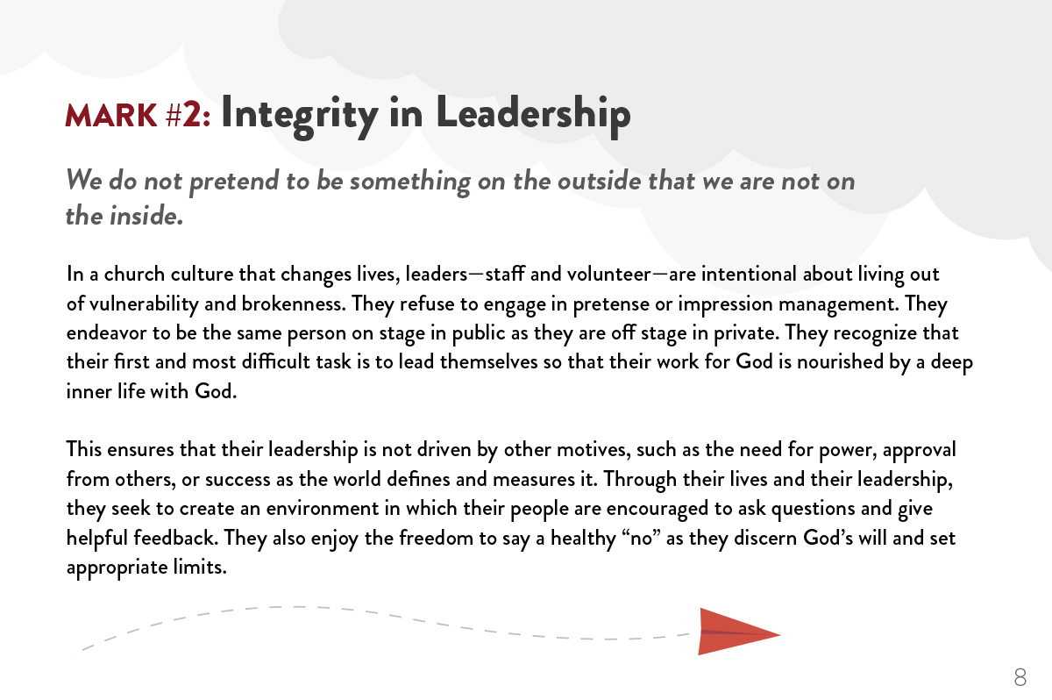
Notes:
Show at 6:55

Slide 9
Notes:
Show at 7:51

Slide 10
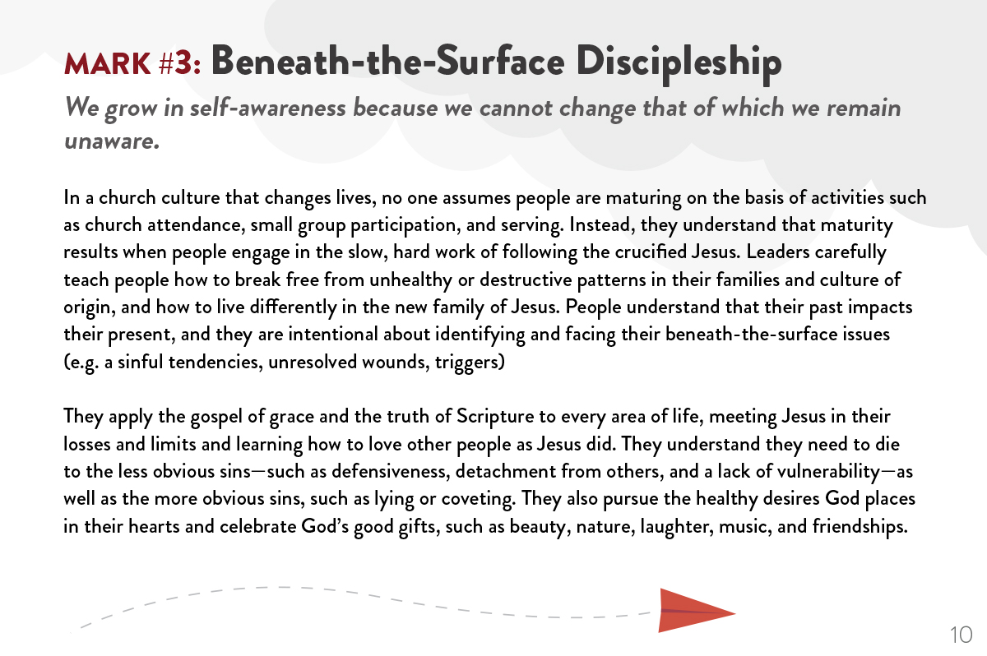
Notes:
Show at 8:01

Slide 11
Notes:
Show at 11:13

Slide 12
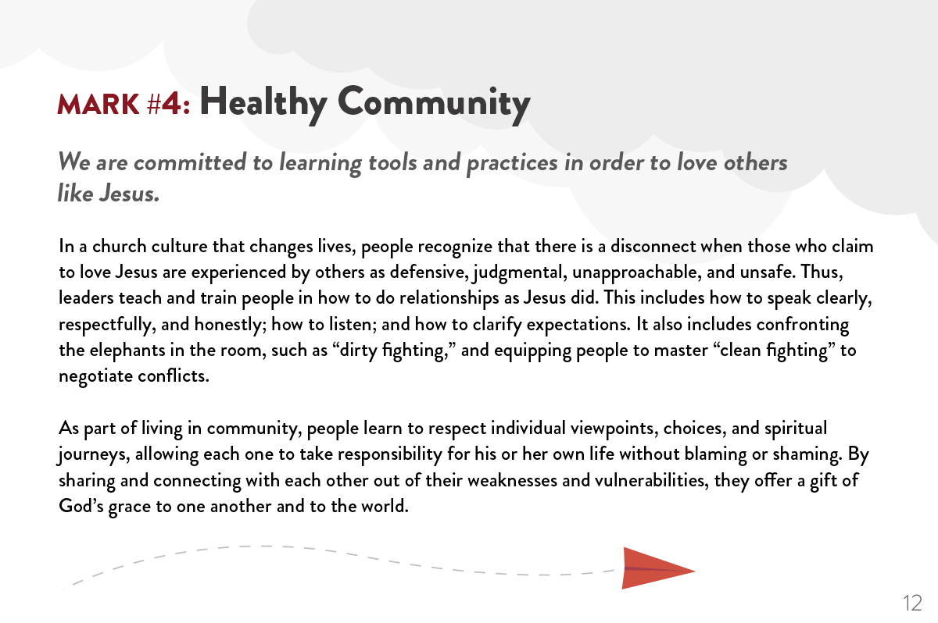
Notes:
Show at 11:23

Slide 13
Notes:
Show at 14:32

Slide 14

Notes:
Show at 14:53

Slide 15
Notes:
Show at 17:10

Slide 16

Notes:
Show at 17:25

Slide 17
Got Questions?
Send in your questions to be answered LIVE by Pete towards the end of the webcast.
Use the Q&A widget to submit your questions
Notes:
19:42

Slide 18

Be sure to fill out the survey.
Fill out the survey by clicking on the survey widget
in the dashboard.
Notes:
21:42

Slide 19

Emotionally Healthy Discipleship Course
By Pete Scazzero
The Leader’s Kit Includes one each of:
Emotionally Healthy Spirituality trade book
Emotionally Healthy Spirituality Day by Day book
Emotionally Healthy Spirituality Course Workbook
Emotionally Healthy Spirituality Course DVD and the Emotionally Healthy Spirituality Course Ministry Resource DVD
Emotionally Healthy Relationships Workbook
Emotionally Healthy Relationships DVD
Emotionally Healthy Relationships Day-by-Day book
Notes:
22:42

Slide 20
Emotionally Healthy Discipleship Course
By Pete Scazzero
Leader’s Kit
$149.99 | NOW $89.99
40%
OFF
Click on the kit icon to purchase.
Notes:
24:42

Slide 21
Got Questions?
Send in your questions to be answered LIVE by Pete towards the end of the webcast.
Use the Q&A widget to submit your questions
Notes:
26:00

